Slide 2
HCLS Land Acknowledgement
We want to respectfully honor the Susquehannock Confederation who governed, lived, farmed, and hunted on the land now called Howard County. Their nations conceded into land treaties in 1652 and 1661 after English colonizers ended their generational governance and stewardship of the land Howard County is built upon. This practice of land acknowledgement is to honor and respect the indigenous inhabitants both from the past and the present.

Slide 3
Upcoming Events
Freedom to Read Roundtable OCTOBER 15 Sunday, 2:30-4 pm
Hear more from National Book Award-winning author, musician, and screenwriter James McBride. Join with librarians, publishers, poets, authors, and your community in supporting the essential right to read.
In-person as well as virtual
Find more events at hclibrary.org

Slide 4
Books for Discussion Lists
Find our previous BCR lists at https://bit.ly/bfd2024
Paper copies available at all HCLS branches
Find book club tips and more at hclibrary.org

Slide 5
First Round of Selections

Slide 6
Dinosaurs
Beth recommends
by Lydia Millet
FICTION

Slide 7
Mikki's Tip: Technology Assistance at HCLS
Free one hour technology one-on-one appointments with an HCLS Instructor
Learn how to use free library apps for e-books and more!
Schedule your appointment at https://tinyurl.com/hcls1on1 or by calling your local HCLS branch

Slide 8
Lady Tan's Circle of Women
Mikki recommends
by Lisa See
FICTION

Slide 9
The Marriage Portrait
Angela recommends
by Maggie O'Farrell
FICTION

Slide 10
Wendy's Tip
HCLS has over 20 book clubs for adults!
Visit hclibrary.org
Click on "classes & events" tab
Under filters on the left, chose ages 19+ under "age group"
Choose Book Clubs under "program type"
Or search by name of the group

Slide 11
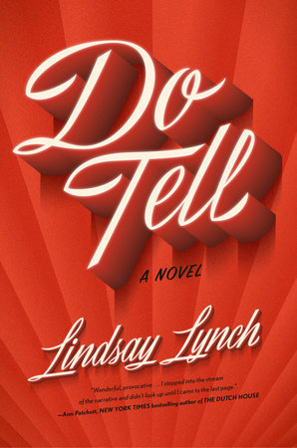
Book Cover
Wendy recommends
Do Tell
by Lindsay Lynch
FICTION

Slide 12
Yellowface
Book Cover
Emily recommends
by R.F. Kuang
FICTION

Slide 13
Someday, Maybe
Angie recommends
by Onyi Nwabineli
FICTION

Slide 14
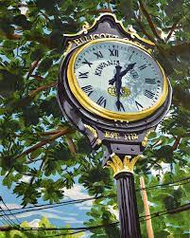
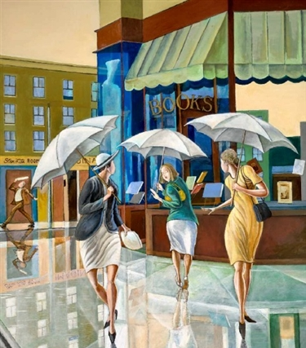
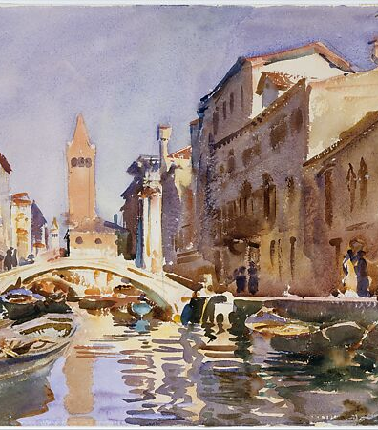
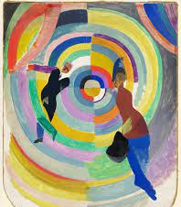
Roslyn's Tip
Hosting a Book Club?
Spruce up your home with a piece from our Art Collection!
Available at Central and Glenwood Branches

Slide 15
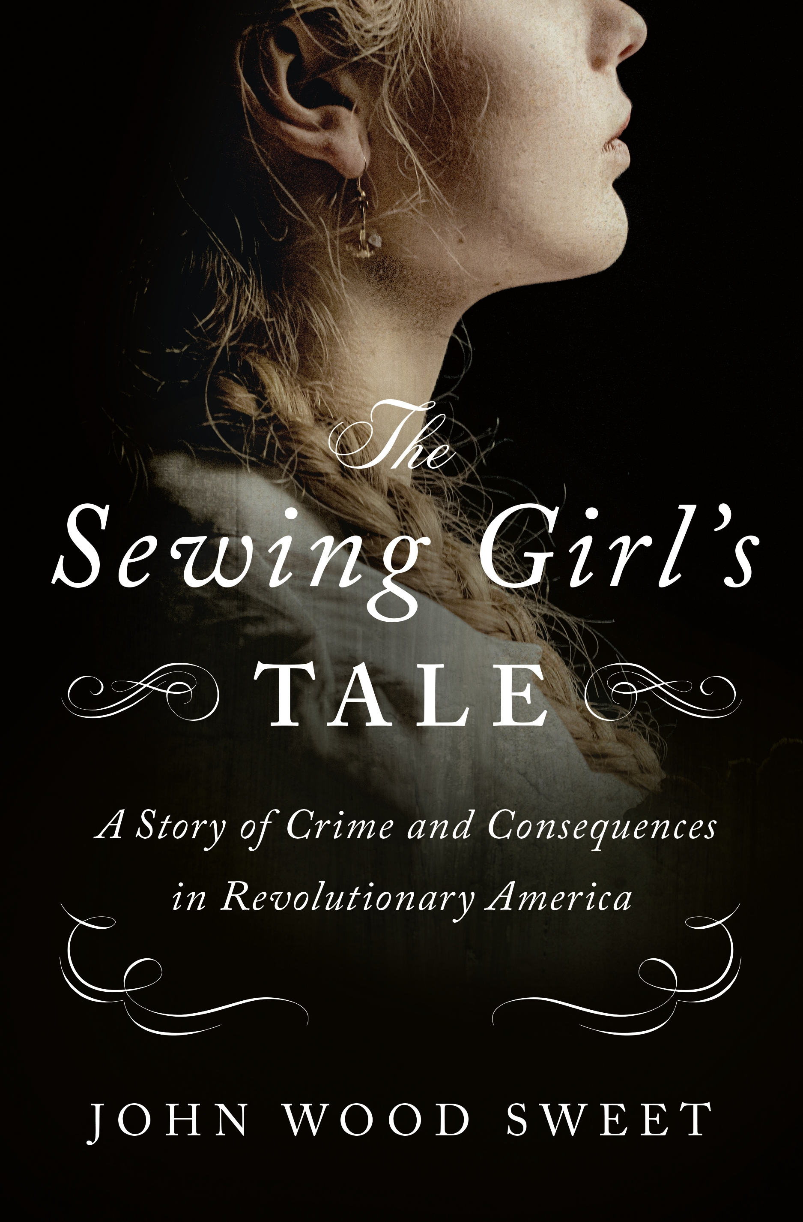
The Sewing Girl's Tale: A Story of Crime and Consequences in Revolutionary America
Roslyn recommends
by John Wood Sweet
NONFICTION

Slide 16
The Golden Spoon
Ash recommends
by Jessa Maxwell
FICTION

Slide 17
Second Round of Selections

Slide 18
The House of Eve
Beth recommends
by Sadeqa Johnson
FICTION

Slide 19
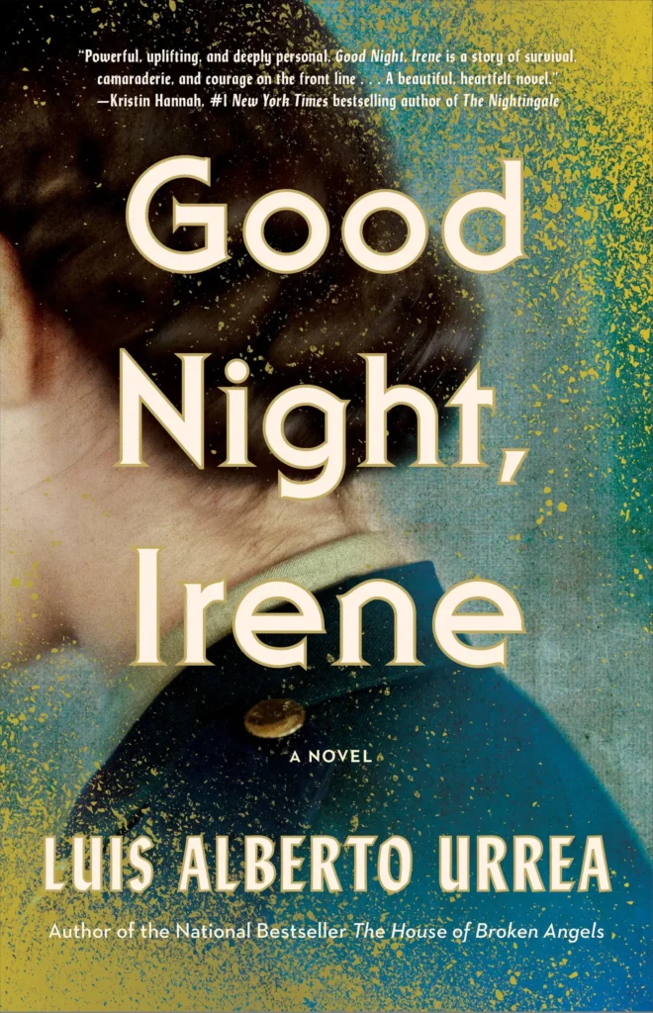
Good Night, Irene
Mikki recommends
by Luis Alberto Urrea
FICTION

Slide 20
Angela's Tip
FREE HCLS ADULT CLASSES!!
Classes are available in a wide range of topics:
Author & movie events, and book clubs
STEM (including computers) and Makerspace
Art & craft, music, DIY, food service and gardening & the environment
Business & finance, community & culture and health & wellness
History & genealogy, and race, equity & inclusion
World languages & writing
Go to our website:
hclibrary.org, click on 'Classes & events', filter for adult events

Slide 21
The Naked Don't Fear the Water: An Underground Journey with Afghan Refugees
Angela recommends
by Matthieu Aikins
NONFICTION

Slide 22
Wendy recommends
Lessons in Chemistry
by Bonnie Garmus
FICTION

Slide 23
Emily's Tip: ReadingGroupGuides.com
Resources include:
Free, printable Reading Guides
'About the book' introduction
Discussion questions
Author biography
Lists of new releases & popular book club picks
Ex: Reese's Book Club, Oprah's Book Club
Excerpt from first chapter of select books

Slide 24
I Have Some Questions for You
Book Cover
Emily recommends
by Rebecca Makkai
FICTION

Slide 25
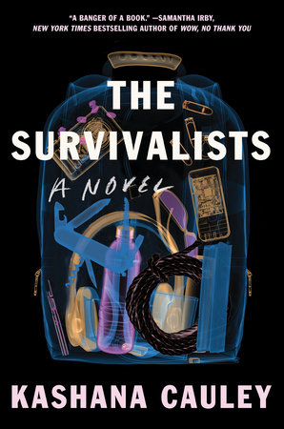
The Survivalists
Book Cover
Angie recommends
by Kashana Cauley
FICTION

Slide 26
Stash
Book Cover
Roslyn recommends
by Laura Cathcart Robbins
NONFICTION

Slide 27
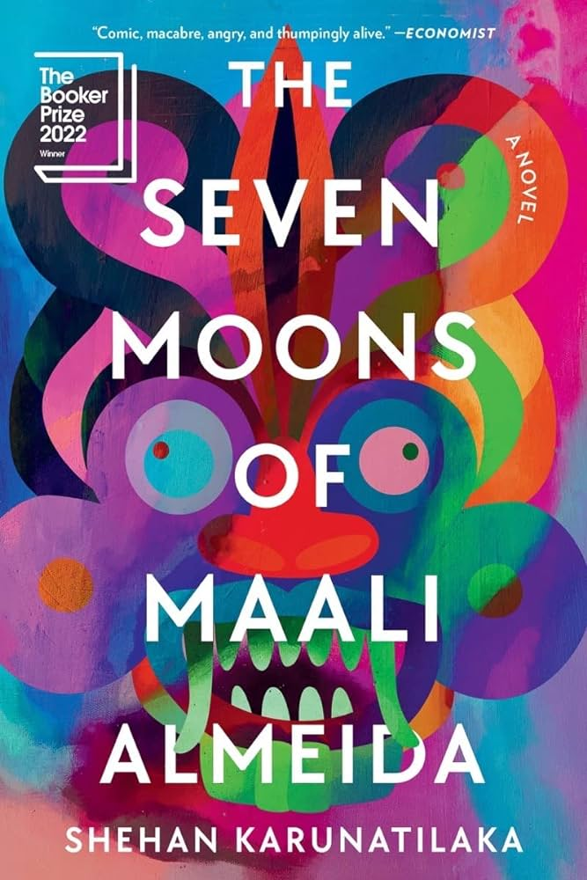
The Seven Moons of Maali Almeida
Ash recommends
by Shehan Karunatilaka
FICTION

Slide 28
Third Round of Selections

Slide 29
Beth's Tip
Don't be afraid of negative reviews.

Slide 30
The Exceptions: Nancy Hopkins, MIT, and the Fight for Women in Science
Beth recommends
by Kate Zernike
NONFICTION

Slide 31
Crook Manifesto
Mikki recommends
by Colson Whitehead
FICTION

Slide 32
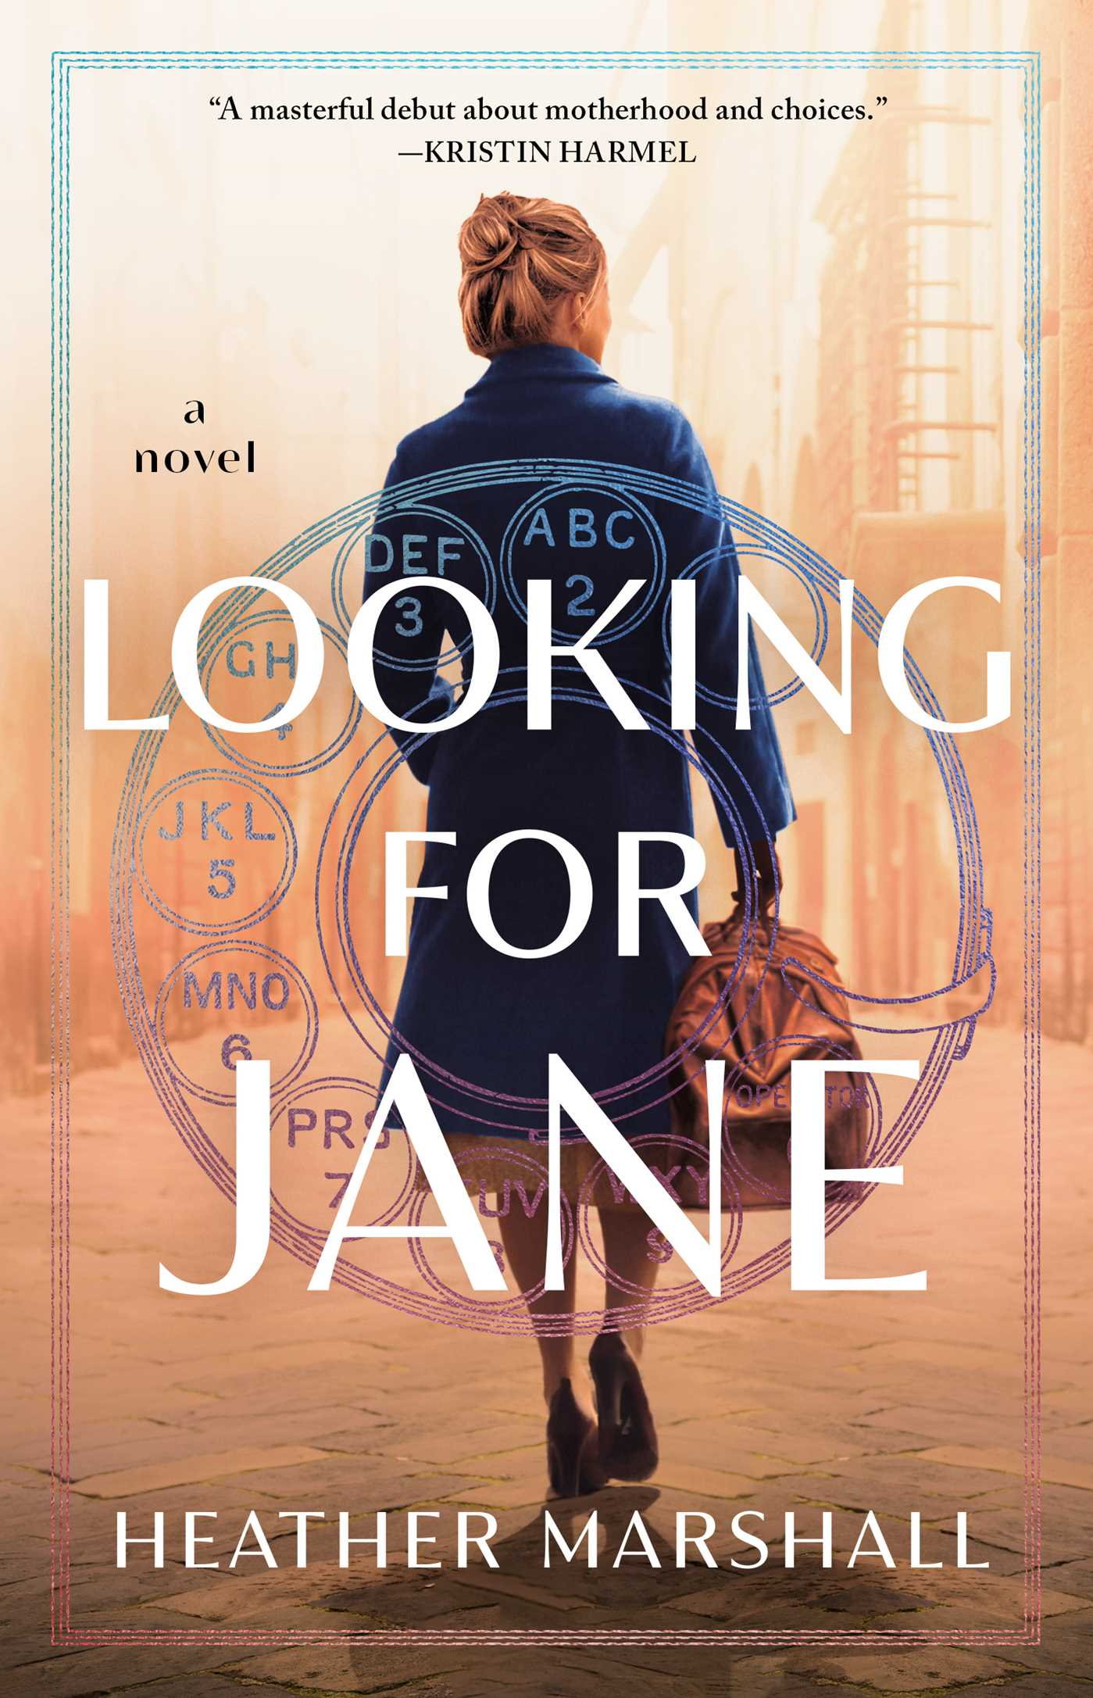
Looking for Jane
Angela recommends
by Heather Marshall
FICTION

Slide 33
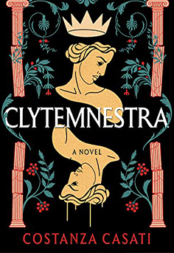
Wendy Recommends
Clytemnestra
by Costanza Cosati
FICTION

Slide 34
A Fever in the Heartland: The Ku Klux Klan's Plot to Take Over America, and the Woman Who Stopped Them
Emily recommends
Book Cover
by Timothy Egan
NONFICTION

Slide 35
Angie's Tip
Did you know there are apps you can use on your phone and tablet that help with book club ideas and selections? They include:
Oku
Fable
Book Binge
Bookclubs
Like Mind
Glose

Slide 36
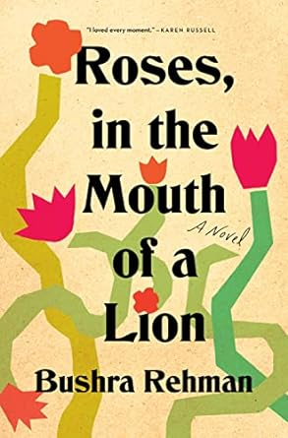
Roses, in the Mouth of a Lion
Angie recommends
by Bushra Rehman
FICTION

Slide 37
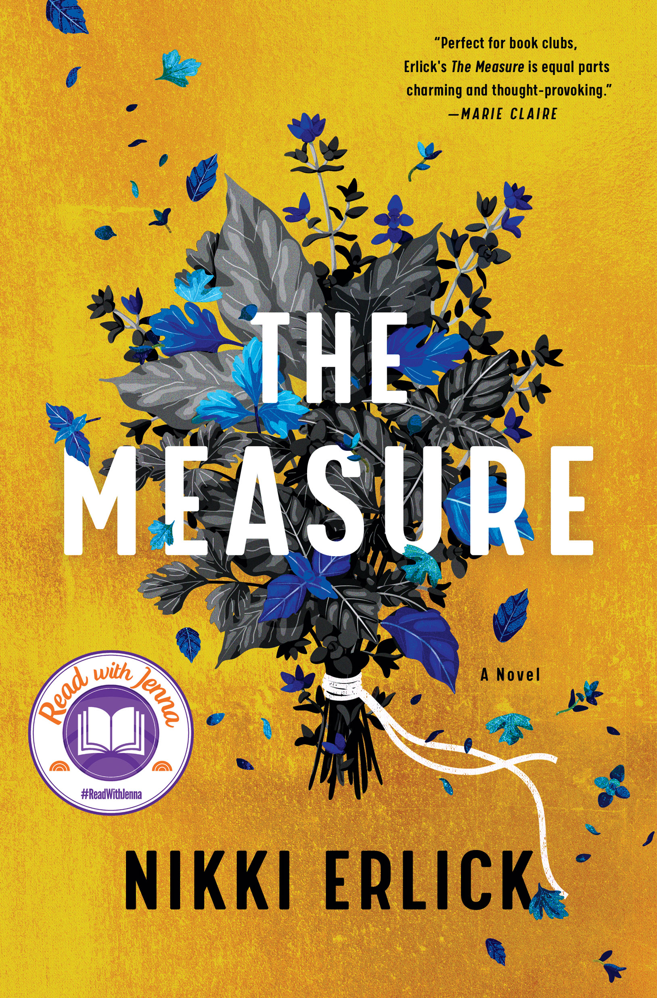
The Measure
Roslyn recommends
by Nikki Erlick
FICTION

Slide 38
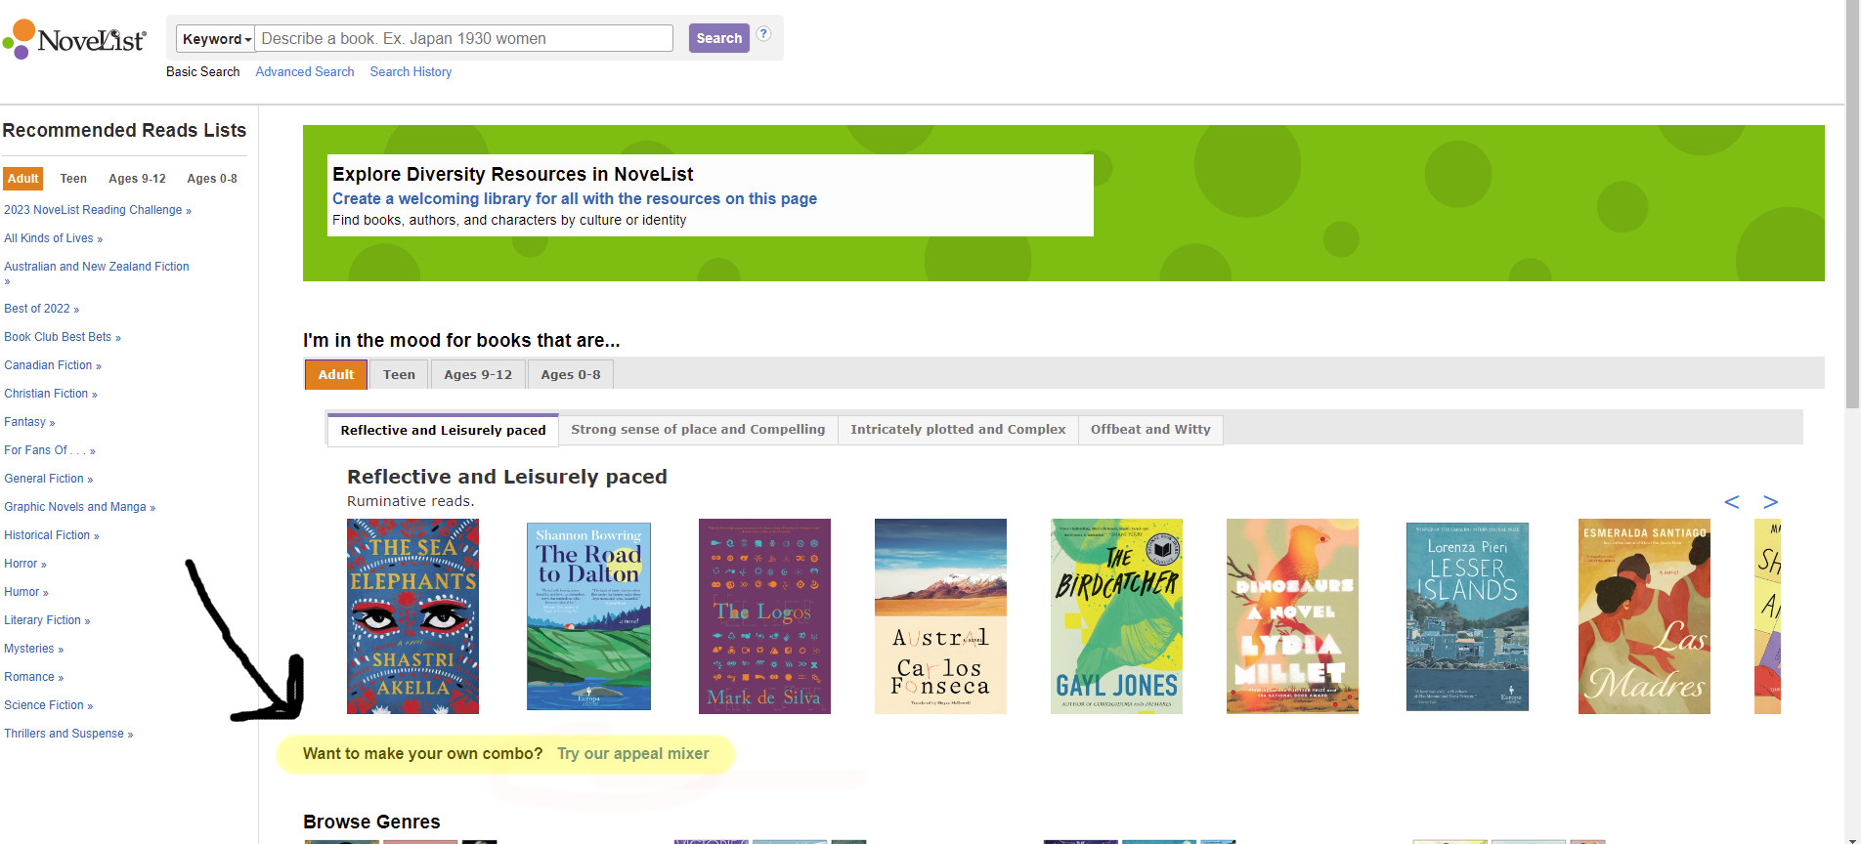
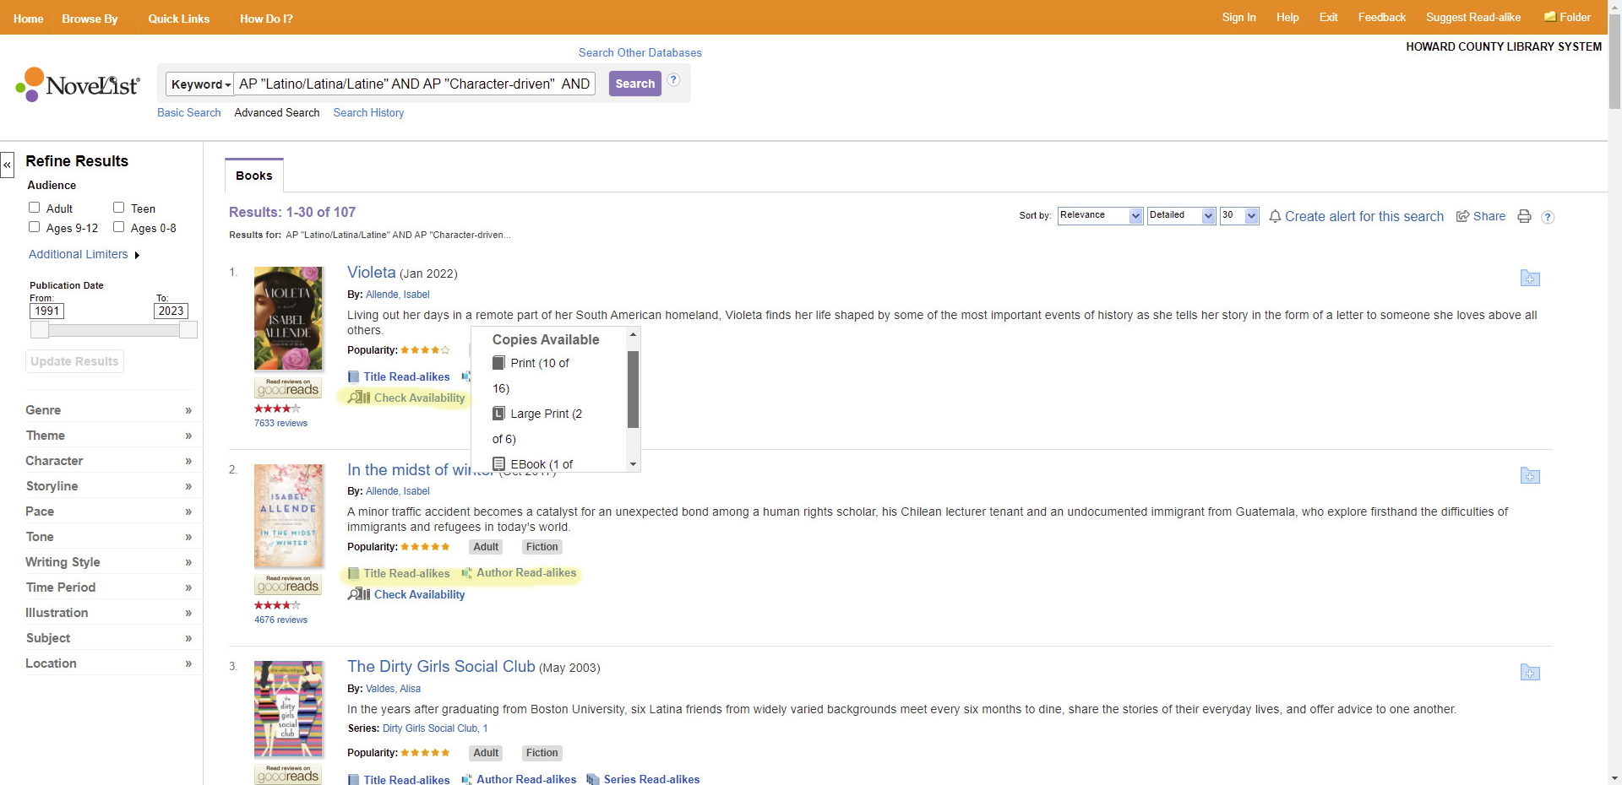
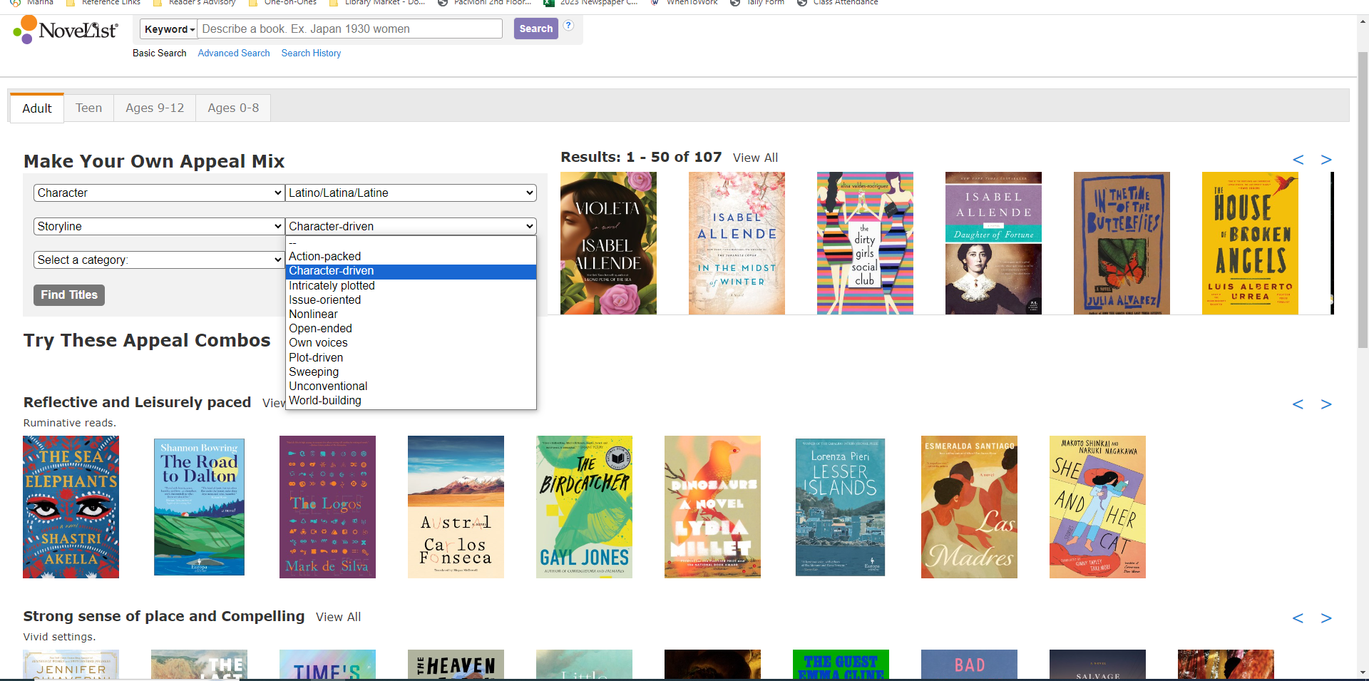
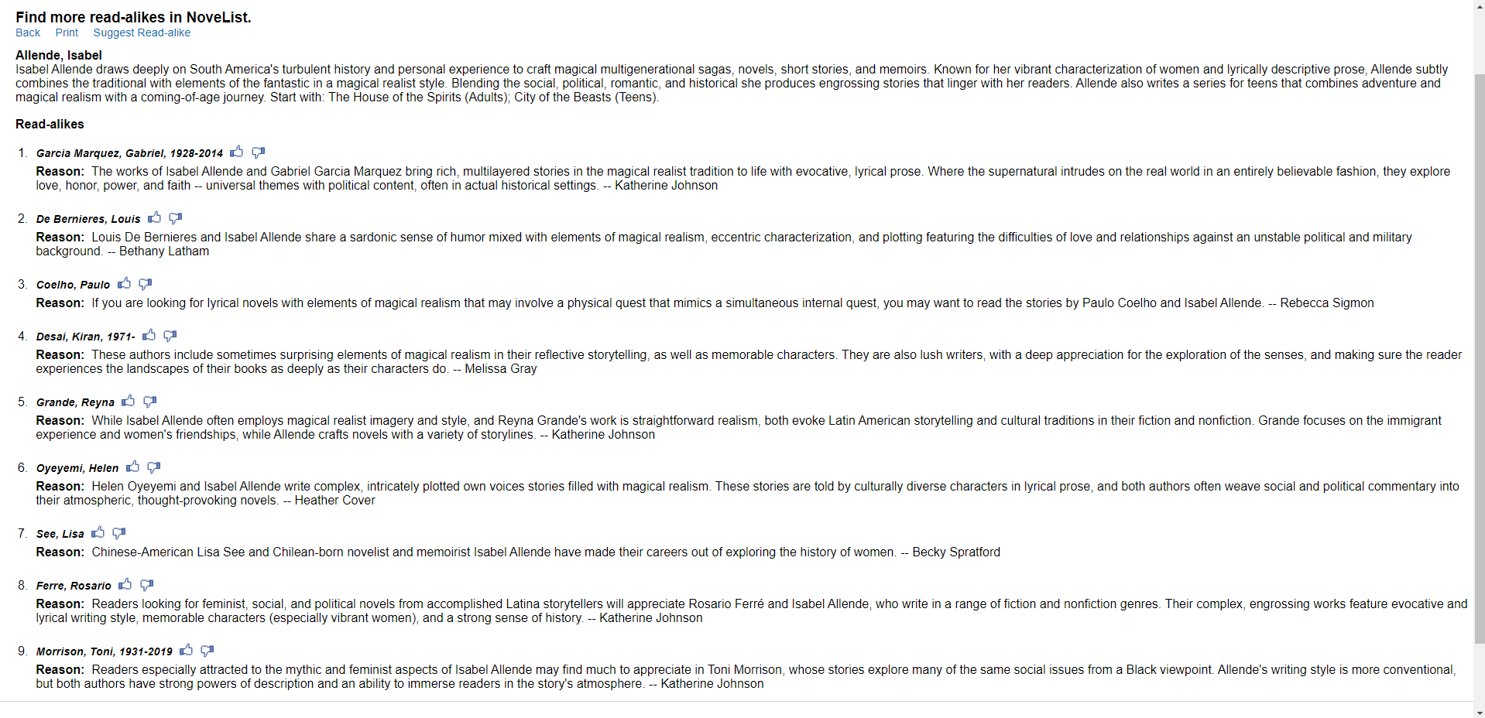
Ash's Tip: NoveList

Slide 39
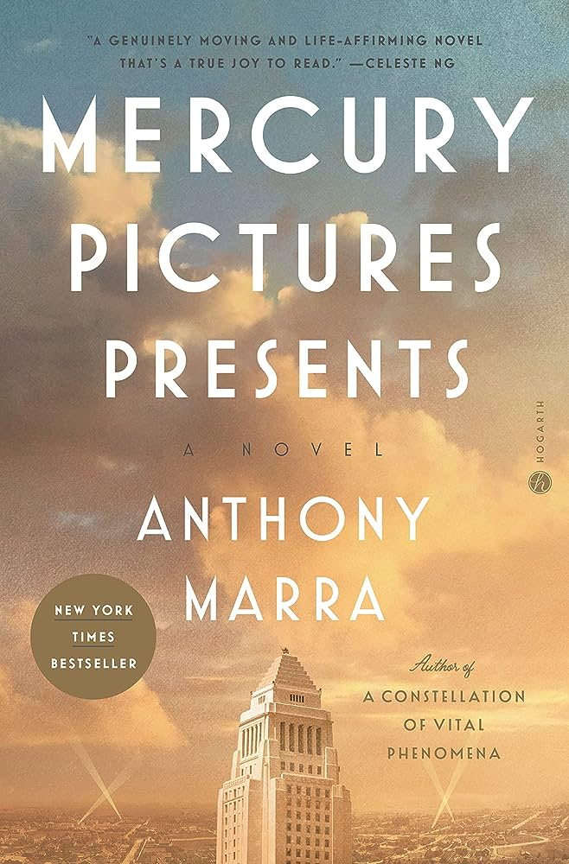
Mercury Pictures Presents
Ash recommends
by Anthony Marra
FICTION

Slide 40
Questions?

Slide 41
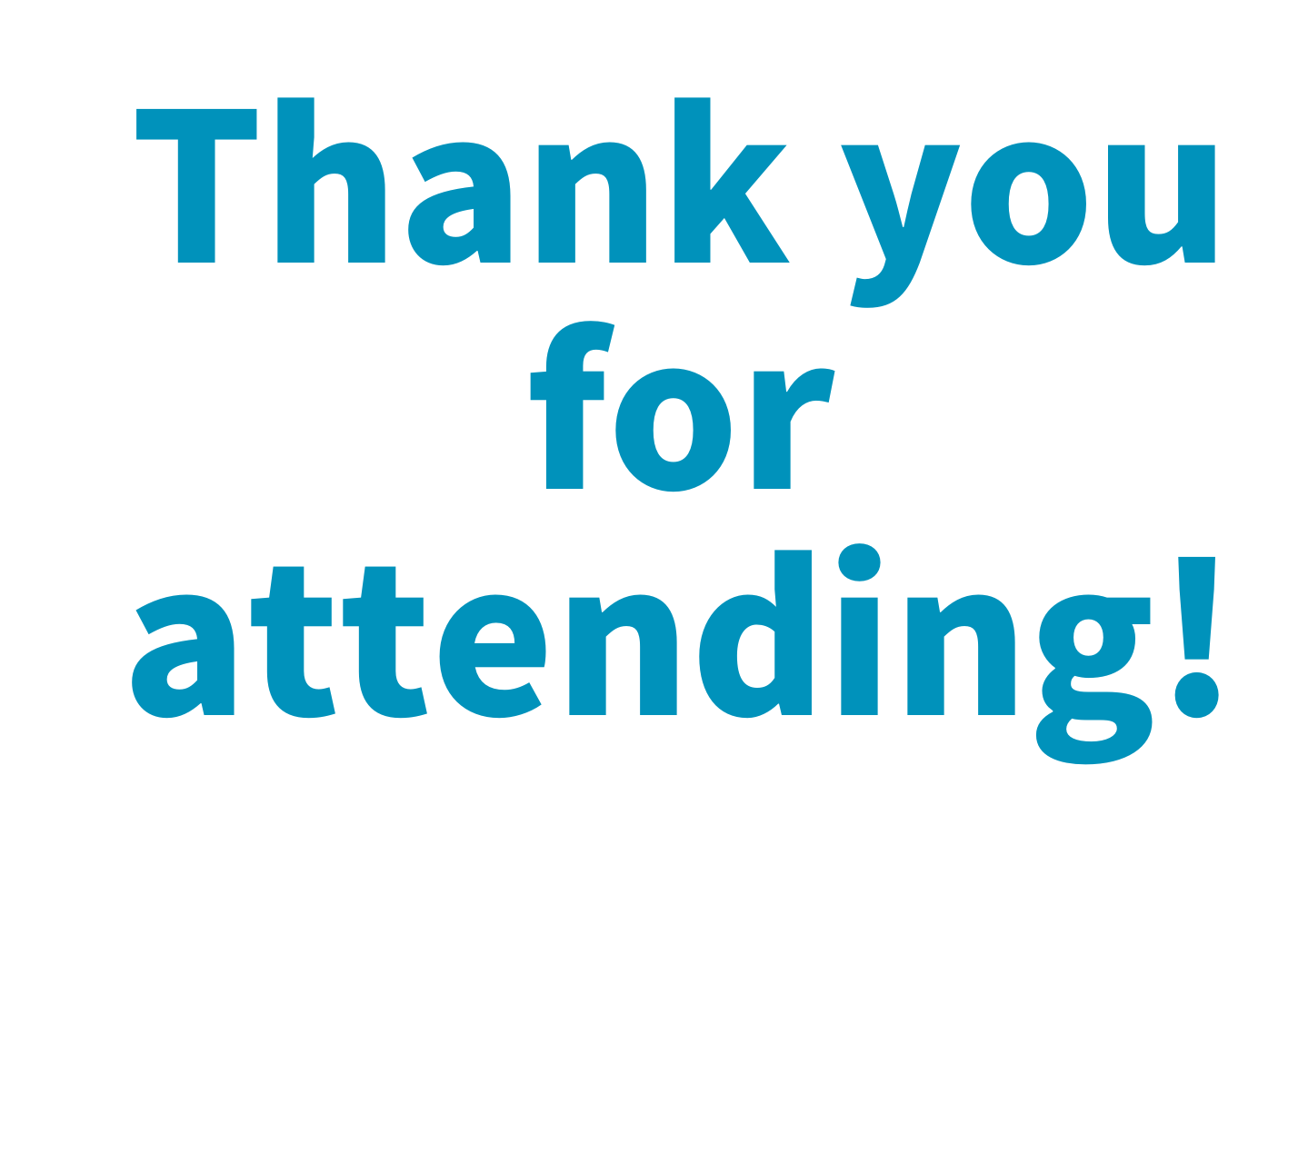
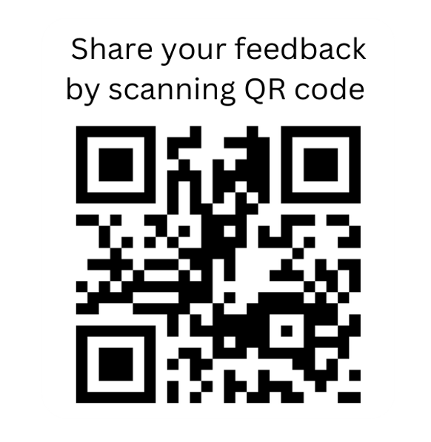
Need to ask a question or share feedback?
Email askhcls@hclibrary.org

